Slide 1


Quantum Communications Group
Key Relay
Group Coordinator:
Armando Nolasco Pinto
anp@ua.pt
Diogo Matos
Group Websites:
https://www.it.pt/Groups/Index/72
LinkedIn: https://www.linkedin.com/company/quantum-communications-group-it-av/

Slide 2
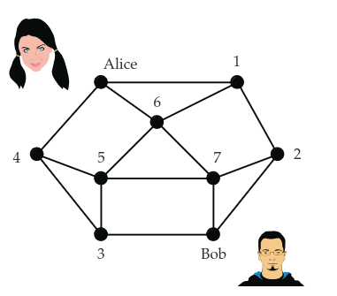
Key Relay
Alice and Bob are in different QKDN nodes that don’t share any QKD module.
Key relay need to happen because the two KMA’s don’t share the same key source.
Process usually managed by the QKDN controller of some kind that is able to trace the best relay routes.

Slide 3
ITU-T
Y.3803
X.1714

Slide 4
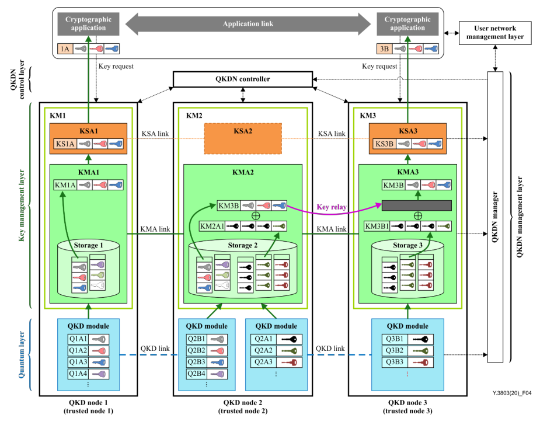
Trusted Key Relay
Key relay using OTP(One Time Pad), which is an IT-secure protocol.
Every relay node will be able to know the key that it’s being relayed.
It’s the method most common on the literature but is very susceptible to security issues.
Distance is not a constraint.

Slide 5
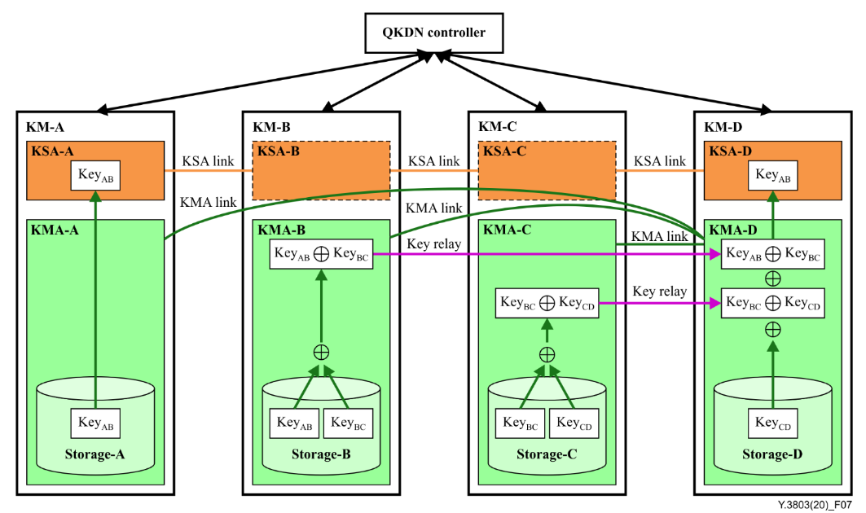
Direct Link Key Relay
Each KMA has a direct link to the destination node.
The XOR ciphertext is directly sent to the destination node.
The key is decrypted by XORing all the relays ciphertexts with its key.
Every KMA has to have a direct link to all the other KMAs. It is impossible in a large real world scenario.

Slide 6
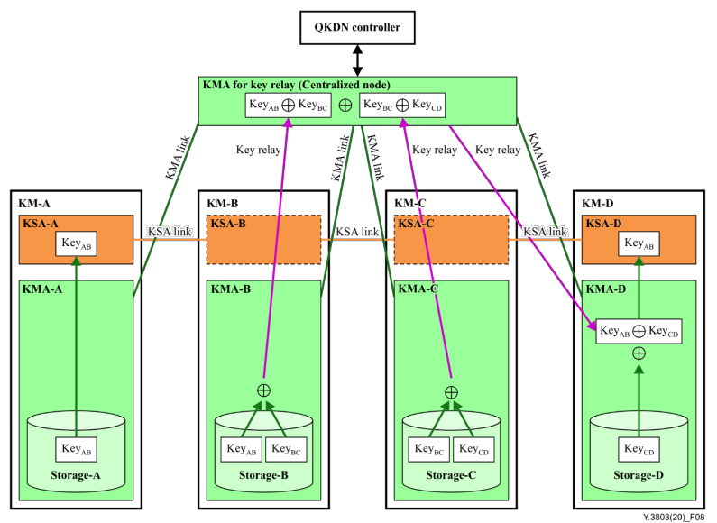
Key relay - centralized key relay node solution
All relay KMAs send the ciphertext to a centralized node. That then XORs all of them and sends the result to the destination KMA.
To decrypt the destination KMA XORs the received ciphertext with its own key.
All KMAs need to have a link to the central relay node. More centralized nodes might be needed in a larger network.
It harder to coordinate and to develop than the first solution, but (theoretically) easier than the last one.

Slide 7
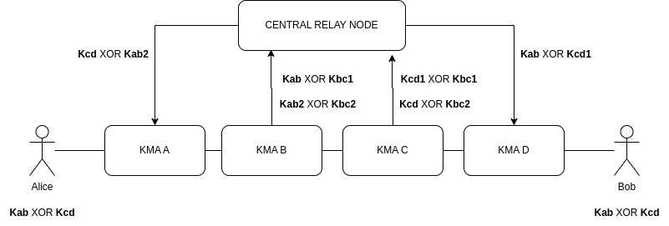
Key relay - centralized key relay node solution
This method has one problem, the relay neighbor of the source KMA will be able to know the key.
A possible solution would be to do the process bidirectionally.
The final key would be the XOR of both keys.

Slide 8
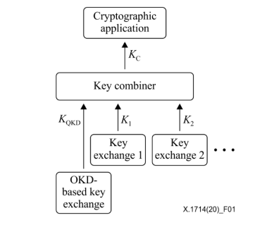
Key relay - key combination
In order to improve the security of the process after the relay is finished, the relayed key can be combined with ones (with equal or smaller size) generated by different classical methods.
K_{QKD} - quantum key (relayed or not)
K_{n} - key (always smaller than K_{QKD} ) provided by any kind of method allowing the exchange of symmetric keys between two nodes, including cryptographic means and physical means
The key combiner can be as simple as a XOR operation between all keys

Slide 9
Multipath transmission
2009 - Hao - Multiple stochastic paths scheme on partially-trusted relay quantum key distribution network
2011 - Rass - Indirect Eavesdropping in Quantum Networks
2014 - Schartner -Quantum Key Management

Slide 10
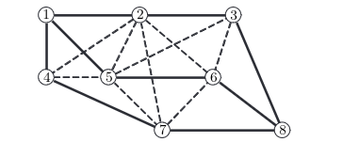
The base idea is to divide the key to be relayed into n equally sized keys and send them through stochastic routes.
The number of nodes on everage that need to be corrupted in order to unveil the key increments as the number of sub-keys and different unique routes arises.
The process can be made in a bidirectionally manner in order to improve security

Slide 11
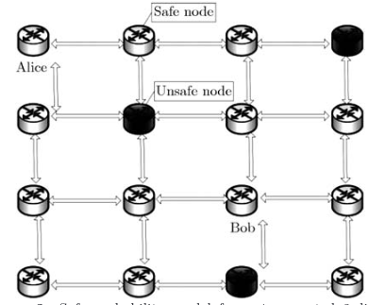
Alice divides her key into n sub-keys and sends each one according to a different route, all ending on Bob. Bob does the same;
Communication secured by OTP;
Each node should relays the key pseudo-randomly (since it follows a specific algorithm) to one of its neighbor nodes;
The shared key is the XOR of Alice’s and Bob’s keys.

Slide 12
Routing Model
A simple distance driven solution
The algorithm to select the next hop is a simple random choice between all neighbors
The destination is absorbent and the source is a unreachable state.
Neighbor nodes closer to the destination have a higher probability to be chosen.
A more abstract solution
The cost of a specific route, most of the times, cannot be measured only based on distances. Other metrics such as the level of trustworthiness and quality of service of a specific node can be used as well.
A single entity (such as the QKDN controller) that knows the topology of the network and all the QOS measurement, can compute a unique relay Markov chain that is used by every node in order to compute the next hop.

Slide 13
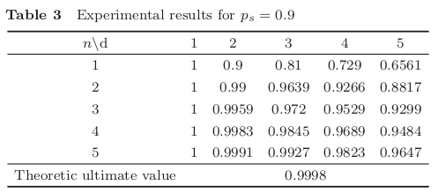
Simulations using the distance driven routing model
Theoretical values are encouraging but show that this method quickly decreases its security as the distance between Alice and Bob is incremented.
Grid network topology it’s ideal since it increases the number of distinct routes between nodes.

